Slide 1
4.1.1. A,b – dna structure
TEXT –
7.1 THE CHEMICAL STRUCTURE OF NUCLEIC ACIDS
&
7.2 THE CHEMICAL STRUCTURE OF DNA

Slide 2
Learning intention Success criteria
Understand that deoxyribonucleic acid (DNA) is a double-stranded molecule that occurs bound to proteins (histones) in chromosomes in the nucleus, and as unbound circular DNA in the cytosol of prokaryotes, and in the mitochondria and chloroplasts of eukaryotic cells.
Recall the structure of DNA, including
nucleotide composition
complementary base pairing
weak, base-specific hydrogen bonds between DNA strands
Perceive that deoxyribonucleic acid (DNA) is a double-stranded molecule that occurs bound to proteins (histones) in chromosomes in the nucleus, and as unbound circular DNA in the cytosol of prokaryotes, and in the mitochondria and chloroplasts of eukaryotic cells
Remember the structure of DNA, including
nucleotide composition
complementary base pairing
weak, base-specific hydrogen bonds between DNA strands

Slide 3
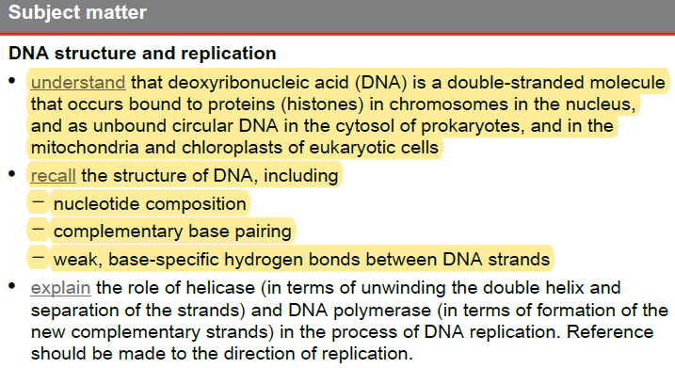
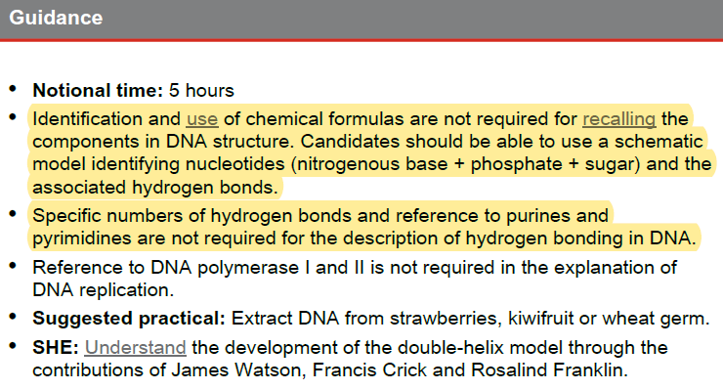
Syllabus check:
By the end of the lesson you should be able to…
NOTE SPECIFICALLY….

Slide 4
DNA

Slide 5
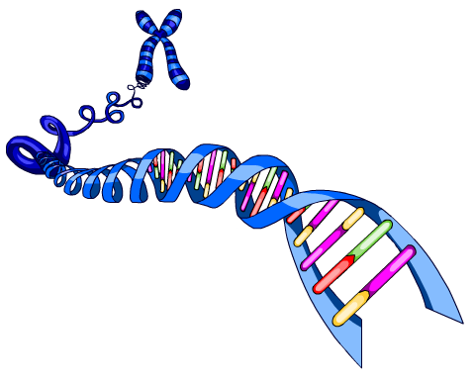
DNA?
Chromosomes and their genes (which we will discuss later) are made of a molecule
called DNA.
DNA stands for
deoxyribonucleic
acid.
Each chromosome
is a very long molecule
of tightly coiled DNA.
DNA molecules carry the code that controls what your cells, and all other cells, are made of and what they do.

Slide 6
What is DNA?
Deoxyribo Nucleic Acid
This chemical substance is present in most living cells.
It can be found in the nucleus of eukaryotes, or the cytosol of; prokaryotes and organelles such as mitochondria and chloroplasts.
It contains a code unique to the individual that can be passed to offspring from generation to generation with little or no change.

Slide 7
What Does it Do?
2
DNA controls all the chemical processes which
take place in cells.
The kind of cell which is formed, (muscle, blood,
nerve etc) is controlled by DNA.
The kind of organism which is produced (buttercup,
giraffe, herring, human etc) is controlled by DNA.

Slide 8
The DNA Molecule and Nucleotide composition
DNA is a very large molecule made up of a long chain of sub-units.
The sub-units are called nucleotides.
Each nucleotide is made up of two consistent subunits:
- a sugar called deoxyribose
- a phosphate group -PO₄
and one variable subunit:
- an nitrogenous (organic) base

Slide 9
Nucleotide composition
Draw the diagram

Slide 10
DNA V’s RNA or Ribose & Deoxyribose
Ribose is a sugar, like glucose, but with only five
carbon atoms in its molecule (we will discuss this molecule later)
Deoxyribose is almost the same but lacks one
oxygen atom
Both molecules may be represented by the symbol

Slide 11
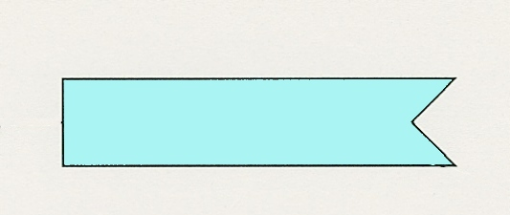
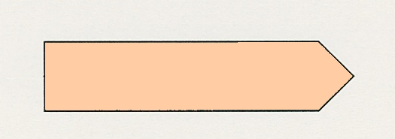
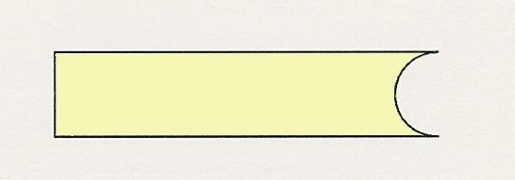
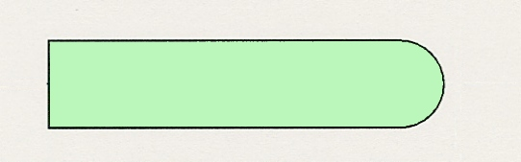
The Nitrogenous Bases
The most common nitrogenous bases are
Adenine
(A)
Thymine
(T)
Cytosine
(C)
Guanine
(G)

Slide 12
Nucleotides
The deoxyribose,
the phosphate
and one of the nitrogenous bases.
Combine to form a nucleotide
PO₄
adenine
deoxyribose
Notes:
It is the phosphate group which gives DNA its acidic properties

Slide 13
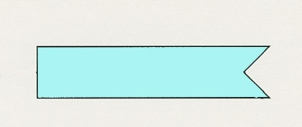
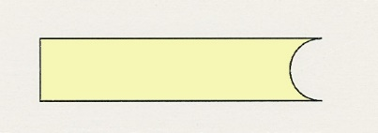
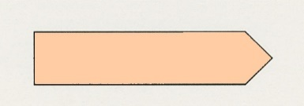
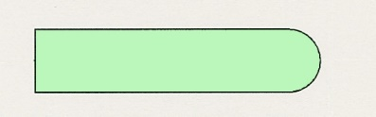
Joined nucleotides
PO₄
A molecule of DNA is formed by millions of nucleotides joined together in a long chain. The phosphate of one nucleotide forms a strong covalent bond with the sugar ring (deoxyribose) of the next nucleotide. Producing a ‘backbone’ to the molecule
PO₄
PO₄
PO₄
sugar-phosphate
backbone
+ nitrogenous bases

Slide 14
In fact, the DNA usually consists of a double strand of nucleotides
The sugar (deoxyribose) - phosphate chains are on the outside
and the two strands are held together by weak base specific hydrogen bonds between the nitrogenous bases.

Slide 15
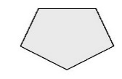
















2-stranded DNA
PO₄
PO₄
PO₄
PO₄
PO₄
PO₄
PO₄
PO₄
PO₄
PO₄
PO₄
PO₄
PO₄
PO₄
PO₄
PO₄

Slide 16
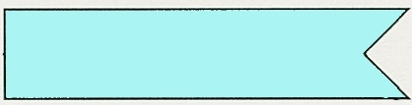
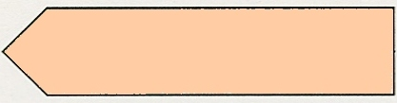
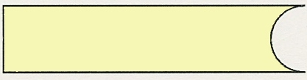
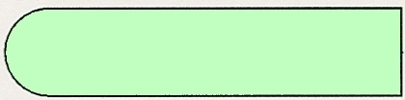
Complementary Nitrogenous Base pairing
The bases always pair up in the same way
Adenine forms a bond with Thymine
Adenine
Thymine
and Cytosine bonds with Guanine
Cytosine
Guanine

Slide 17
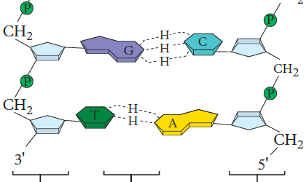

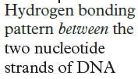

DNA Structure
Because of this complementary base pairing, the order of the bases in one strand determines the order of the bases in the other strand.
The paired nitrogenous bases are chemically bonded together using weak chemical bonds called hydrogen bonds. These bonds are base-specific resulting in the observed base pairing.
Draw the diagram including the hydrogen bonds

Slide 18









Bonding 2
PO₄
PO₄
adenine
thymine
PO₄
PO₄
cytosine
guanine
PO₄
PO₄
PO₄
PO₄

Slide 19
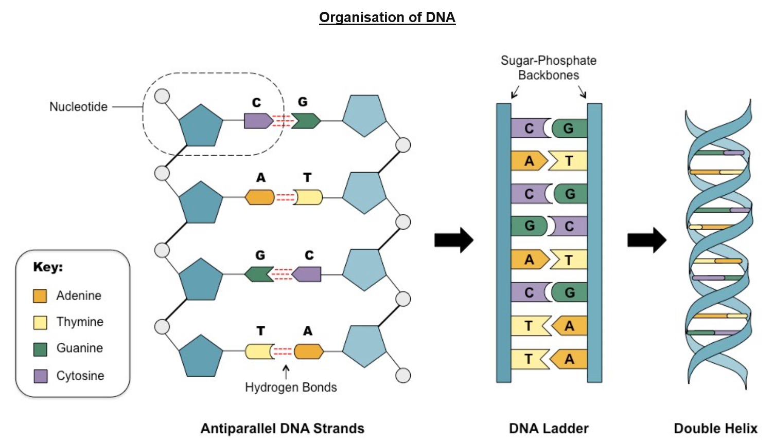
Finally the paired strands are coiled into a spiral called a DOUBLE HELIX. This was proposed as a shape for the molecule by the scientists Watson and Crick the first scientists to formulate an accurate description of this molecule's complex, double-helical structure.

Slide 20
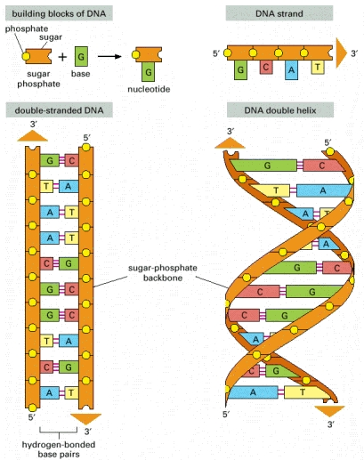

Slide 21
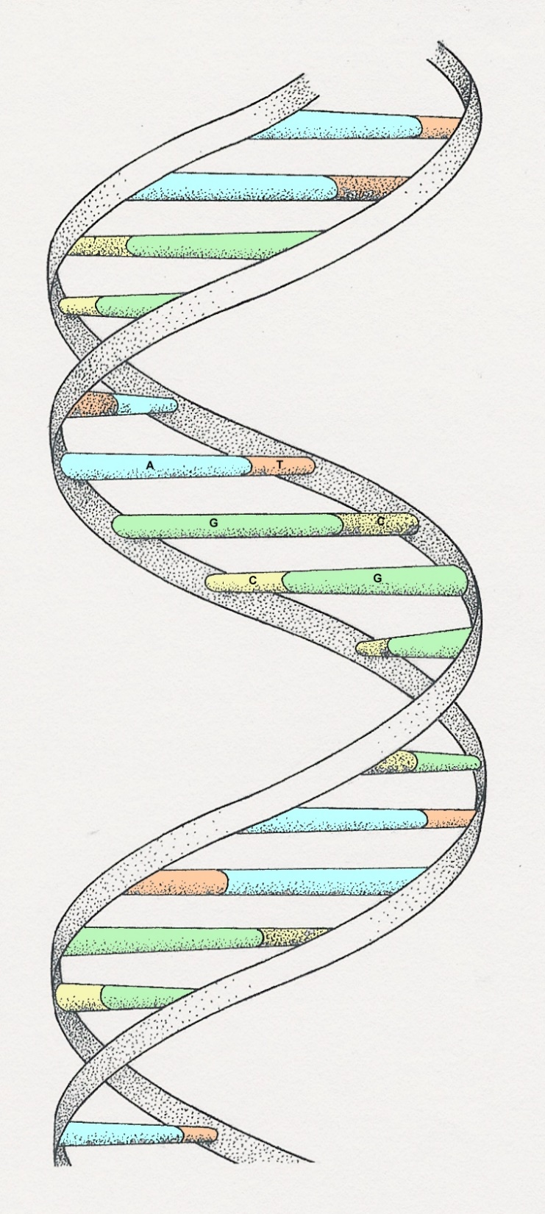
THE DOUBLE HELIX
Complementary Nitrogenous Bases
sugar-phosphate
chain

Slide 22
chromosomes

Slide 23
What are chromosomes?

Slide 24
Basic Structure of DNA

Slide 25
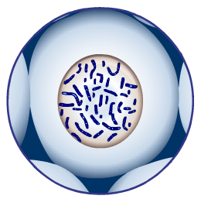

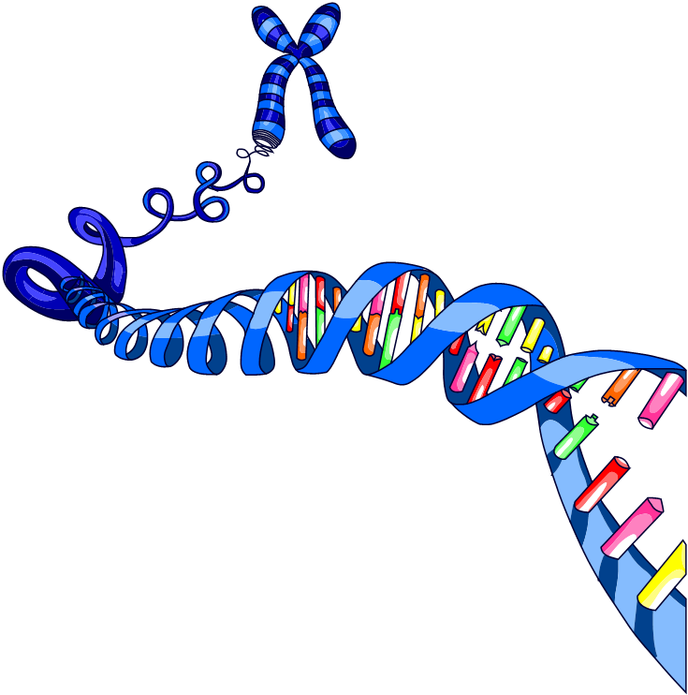
What are chromosomes?
Chromosomes are strands or circular or linear genetic information located in the nuclei or cytosol of cells.
Eukaryotic chromosomes are most visible
during cell division when they
replicate and look like this…
You will see chromosomes represented both ways.

Slide 26
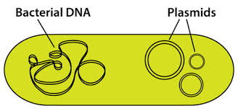
Prokaryotic Chromosome Structure
Prokaryotes have one chromosome consisting of a single circular DNA molecule (chromosome). This DNA in not bound by a nuclear membrane or to histone packing proteins, but can be found in the cytosol of the cell.
Some prokaryotes also have plasmids but eukaryotes do not.
Eukaryotic organelles such as mitochondria and chloroplasts have their own similarly unbound circular DNA.

Slide 27
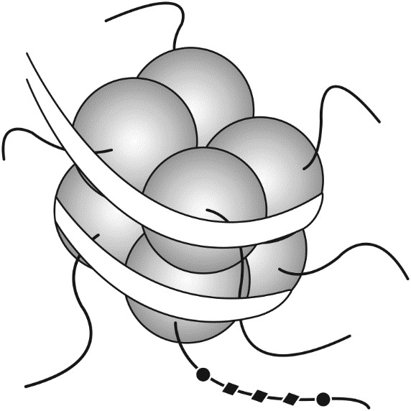
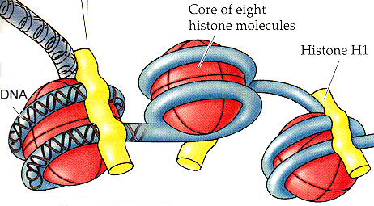
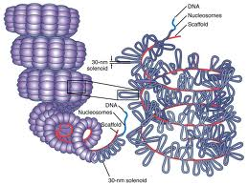
Eukaryotic Chromosome Structure
Eukaryote chromosomes are linear DNA molecules. They are bound by a membrane to form the nucleus of the cell.
To organise the DNA and prevent it from tangling each strand is bound to a group of 8 proteins called histones. The DNA-histone complex that is formed is called a nucleosome. Because DNA wraps around histones, they also play a role in gene regulation.
Draw the diagram of a nucleosome (to the left).
Note the 8 histone molecules and the DNA wrapped around it

Slide 28
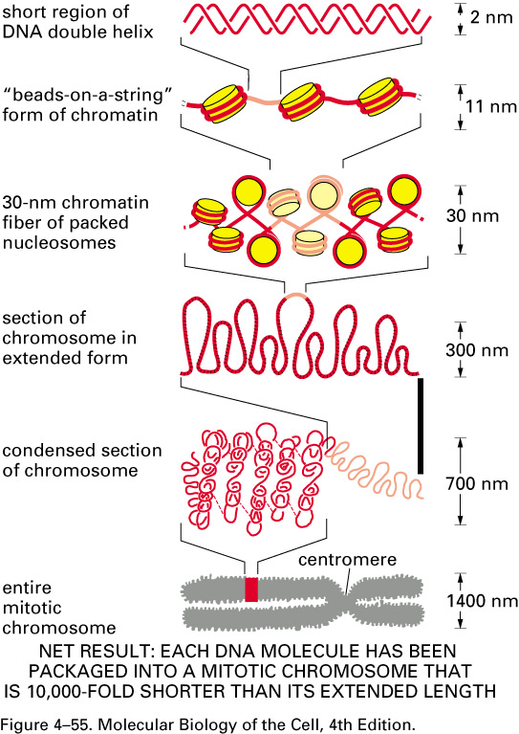
Chromatin Packing
Condensin plays important roles

Slide 29
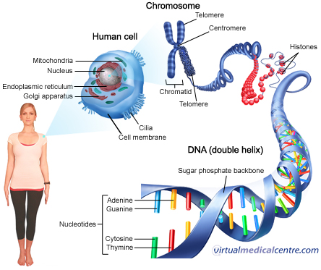
cell>nucleus>chromosome>DNA>gene

Slide 30
Exit ticket: a. Understand that deoxyribonucleic acid (DNA) is a double-stranded molecule that occurs bound to proteins (histones) in chromosomes in the nucleus, and as unbound circular DNA in the cytosol of prokaryotes, and in the mitochondria and chloroplasts of eukaryotic cells. PA MOCKEXAM 2020 SA2
QUESTION 3 (4 marks)
Explain two of the differences between DNA found in eukaryotes and prokaryotes.

Slide 31
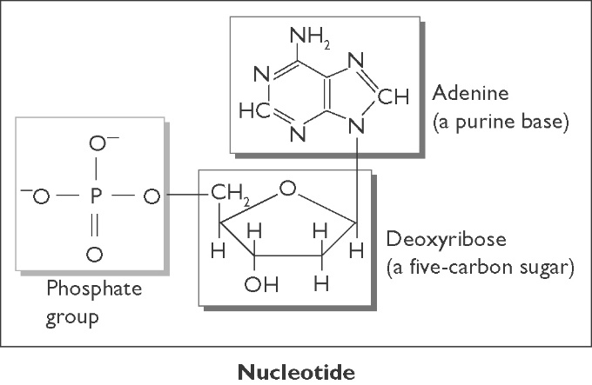
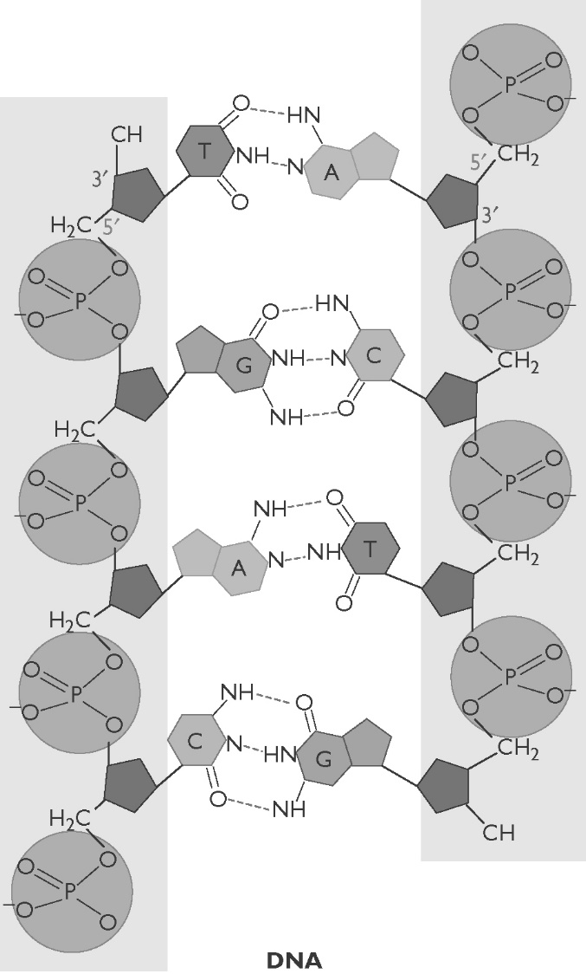
Exit ticket: B. Recall the structure of DNA, including nucleotide composition complementary base pairing weak, base-specific hydrogen bonds between DNA strands PA MOCKEXAM 2020 SA2
A) Recall the pairing arrangement of the four types of nitrogenous bases. (2 marks)
B) Recall the molecules in the nucleotides that form the ‘backbone’ of the DNA ‘ladder’. (2 marks)
C) Describe the molecular structure of DNA in terms of nucleotides. (3 marks)

Slide 32
Further research
DNA Structure and Function.
“DNA” (Khan Academy)
https://www.youtube.com/watch?v=_-vZ_g7K6P0
2. DNA Structure and Replication.
“DNA Structure and Replication: Crash Course Biology #10” (Crash Course)
https://www.youtube.com/watch?v=8kK2zwjRV0M

